Slide 1
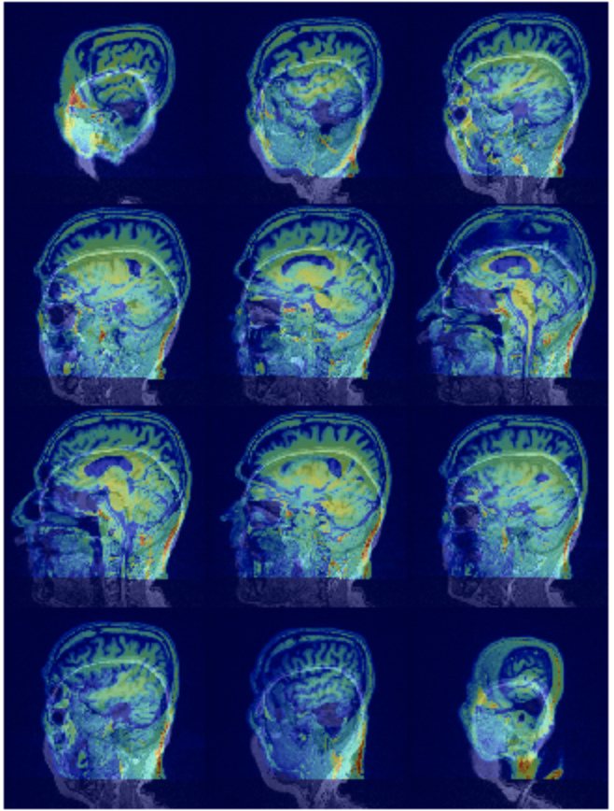
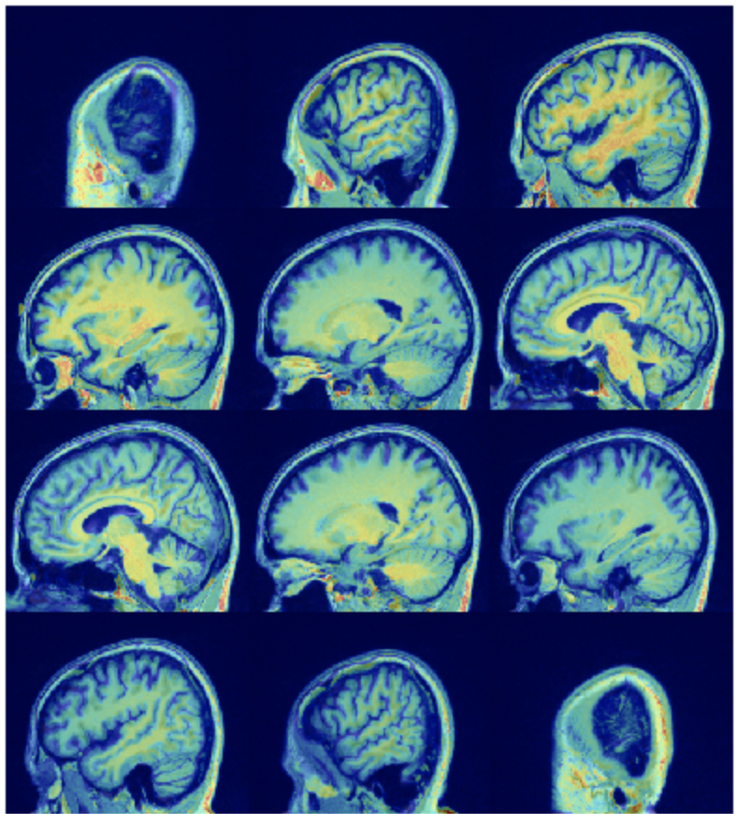
Classification and Visualization of Alzheimer’s Disease using Volumetric Convolutional Neural Network
Daniel Brennan
Arezoo Bybordi
Andrea Ceres

Slide 2
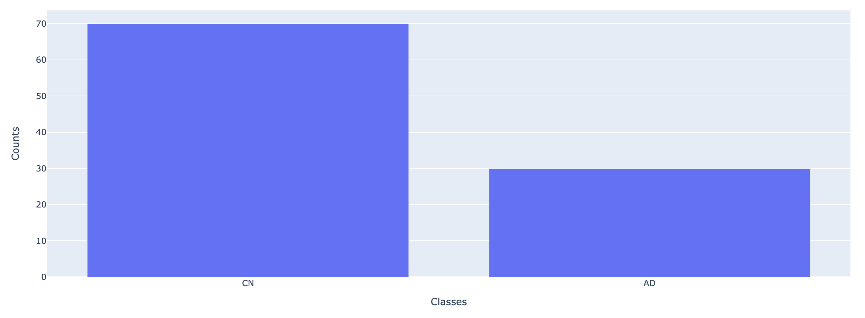
Problem Description
Classifying neuroimaging data related to Alzheimer disease.
Alzheimer’s disease (AD) vs Cognitively Normal (CN)
Dataset with 1098 brain images. (980 used)
Input: MRI images
Target variables are labels AD and CN.
Dataset reference: https://www.oasis-brains.org
Data classes are not balanced. (70% CN, 30% AD)

Slide 3
Approach
Train a 3D convolutional autoencoder to learn the features that are useful to classify images into AD and CN.
Train another 3D convolutional autoencoder with Inception module to learn the features that are useful to classify images into AD and CN.
Build a classifier to classify images into AD and CN using the encoder part of the models.
Using a visualization technique, check which patterns the trained network found useful to do the classification.
Reference: Oh, K., Chung, Y., Kim, K.W. et al. Classification and Visualization of Alzheimer’s Disease using Volumetric Convolutional Neural Network and Transfer Learning. Sci Rep 9, 18150 (2019).

Slide 4
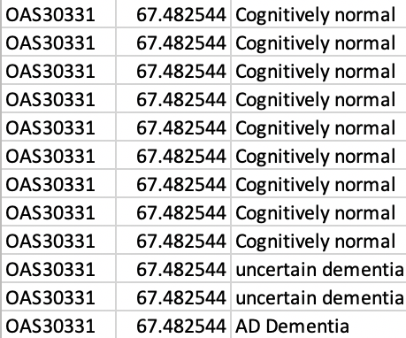
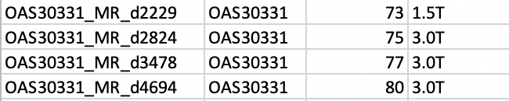
Data Preprocessing
Determine Scan IDs
Medical data: messy!
Multiple scans, multiple diagnostic rows
Download Data
Download script provided
Storage: Google Drive
Processing: G. Colab

Slide 5
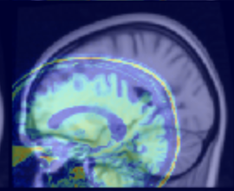
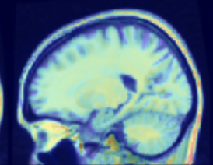
Data Preprocessing
Image Alignment
Using AntsPy*
Align to “Standard” T1 image + normalize for further processing
Manual Inspection
Visually inspect success of alignment procedure
Note failures, adjust accordingly
*https://pypi.org/project/antspyx/

Slide 6
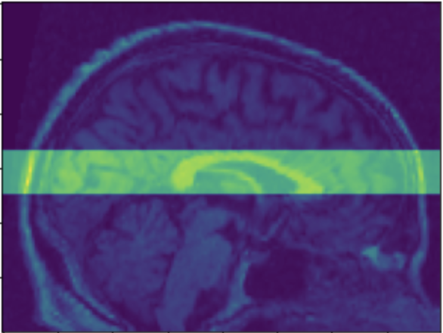
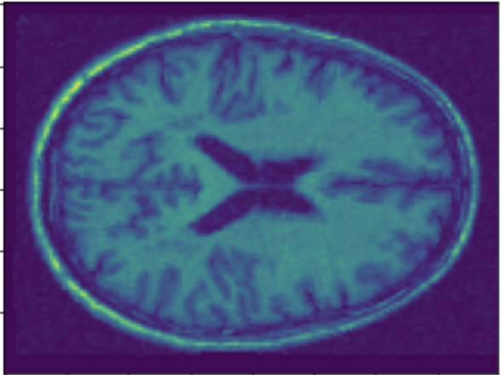
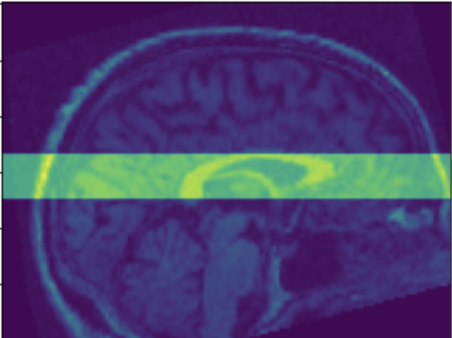
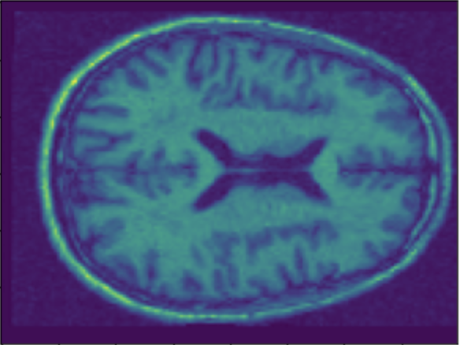
Data Augmentation
Slice: 16 slices focused on ventricles
Augmentation: rotation in random direction
Slice after rotate: lots of unique data
15 deg

Slide 7
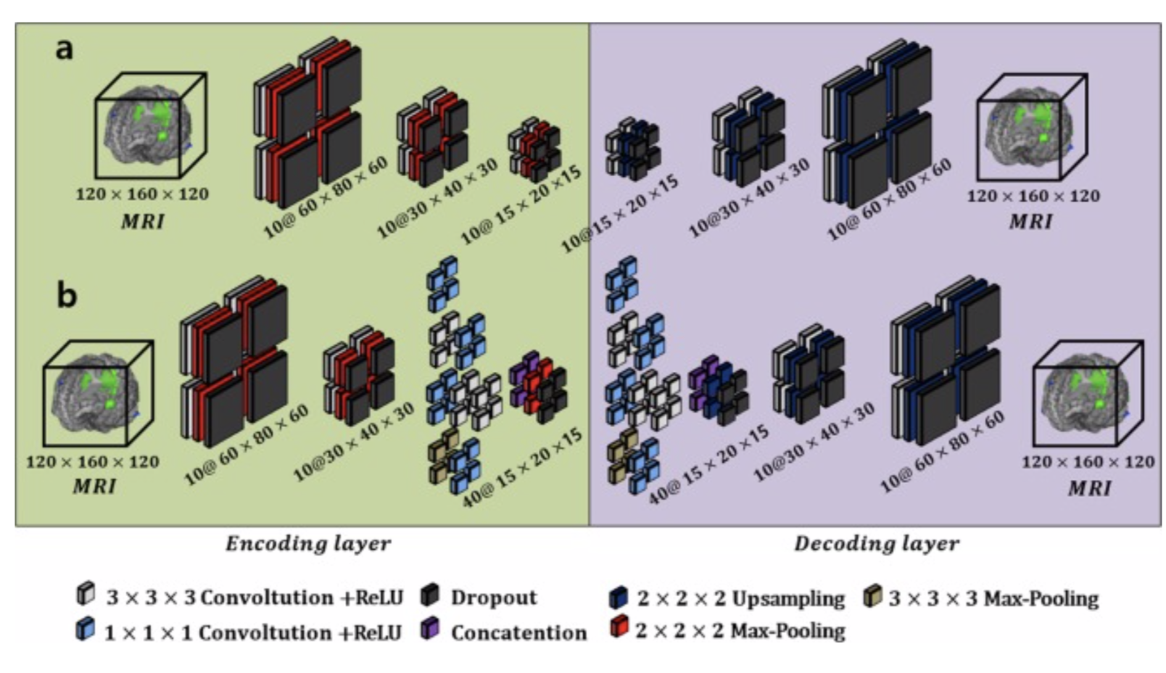
Building Autoencoder
Input images dimensions:
120 by 160 by 120
Three convolutional layers
10 feature maps each
Each convolution followed by size 2 max pooling and 0.8 dropout
Two 32- and 16-node layers fully connected
1.44 M parameters for the encoder

Slide 8
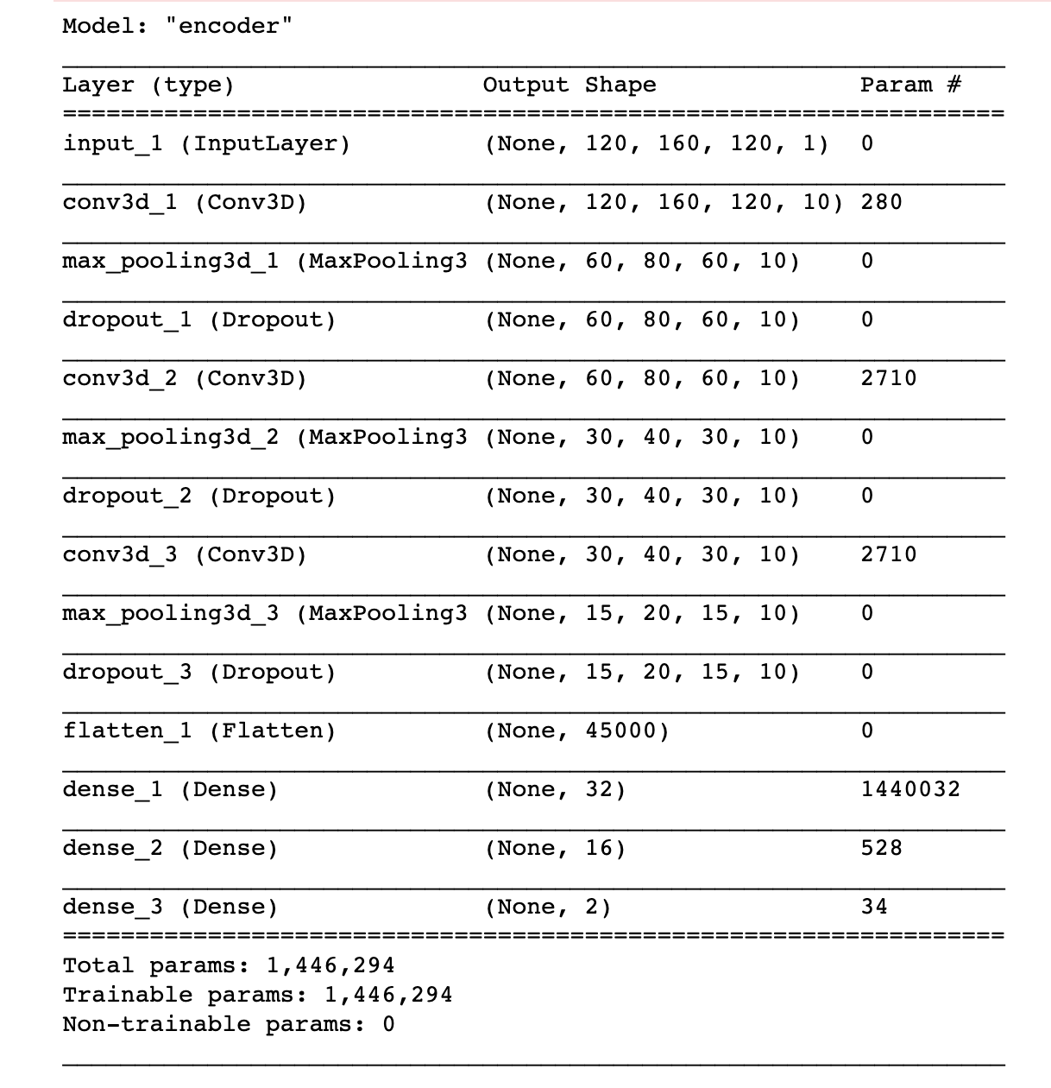
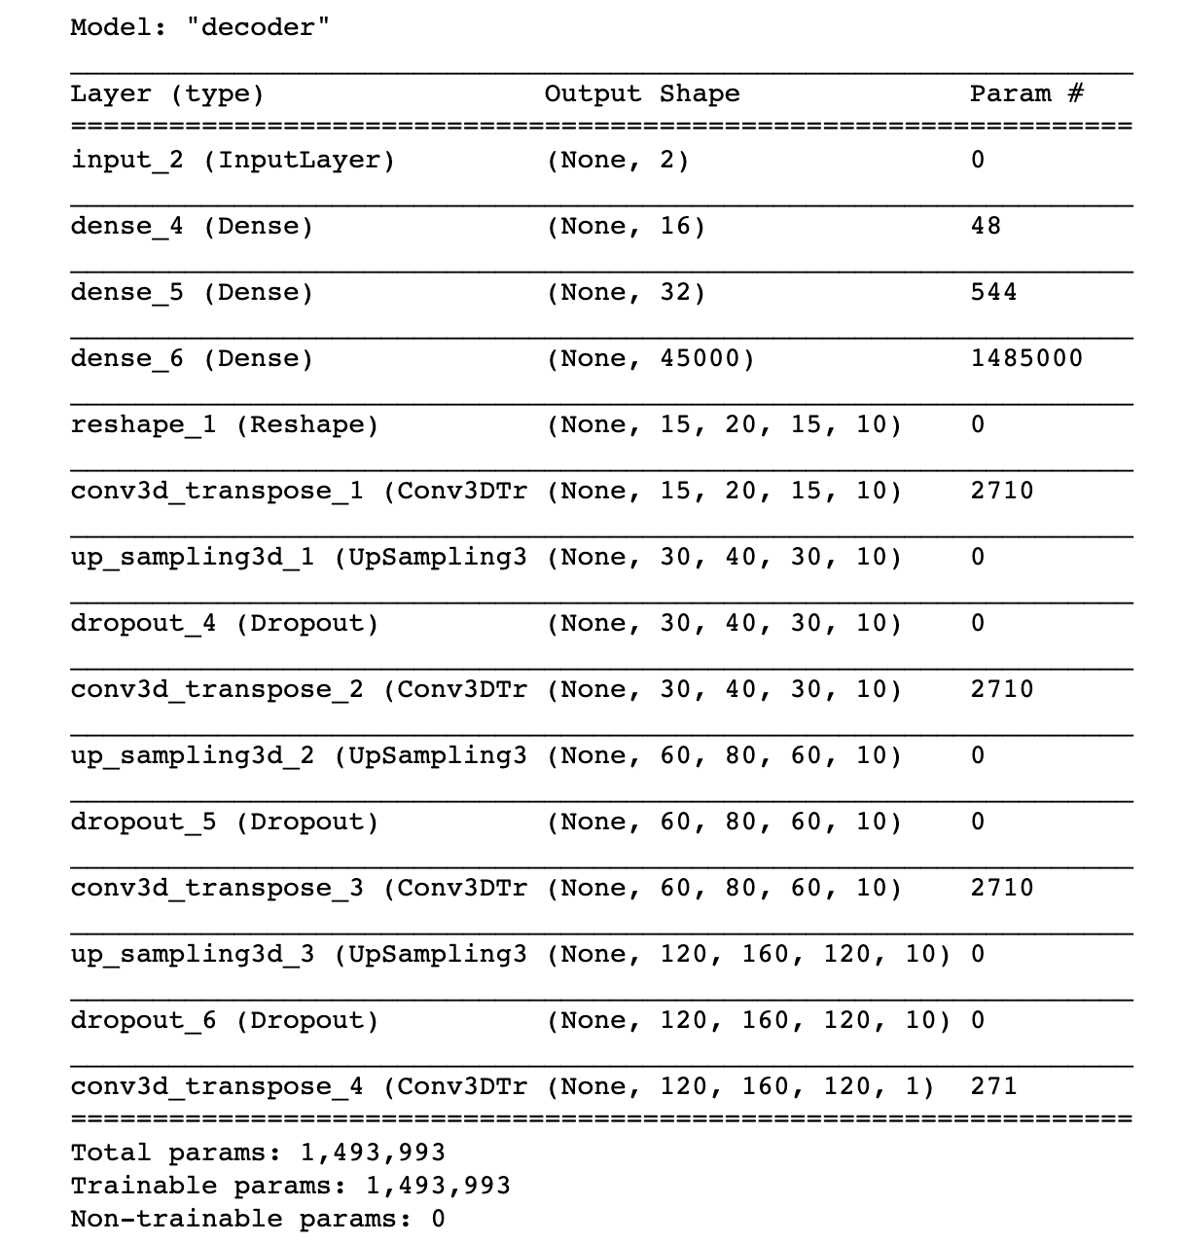
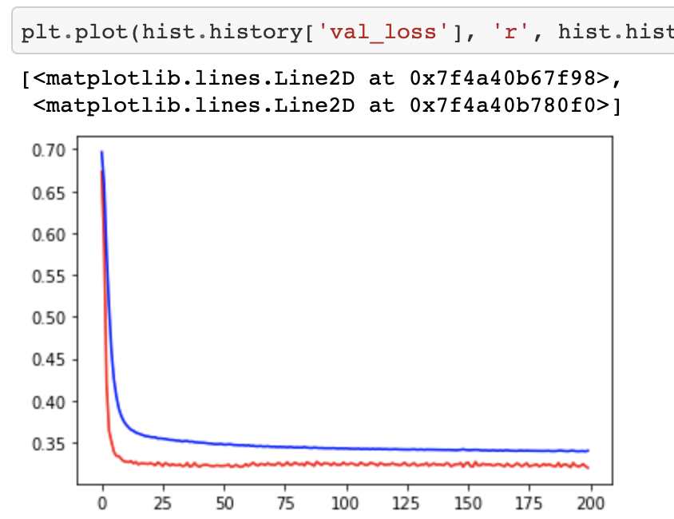
CAE Autoencoder summary

Slide 9
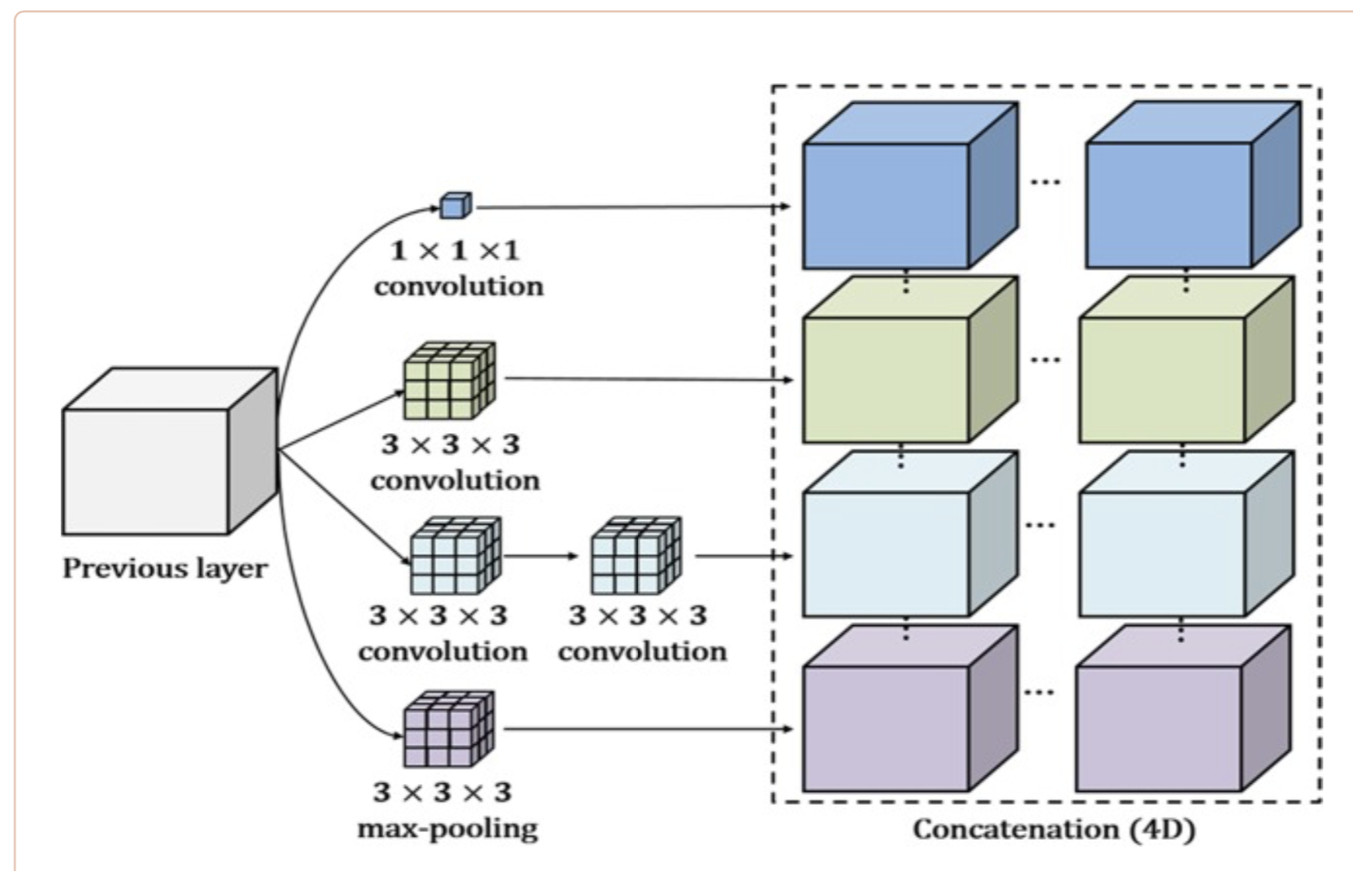
Building Autoencoder with Inception Module
Input images dimensions:
120 by 160 by 120
Two convolutional layers
10 feature maps each
Each convolution followed by size 2 max pooling and 0.8 dropout
Inception block based on GoogLeNet v2, followed by size 2 max pooling and 0.8 dropout

Slide 10
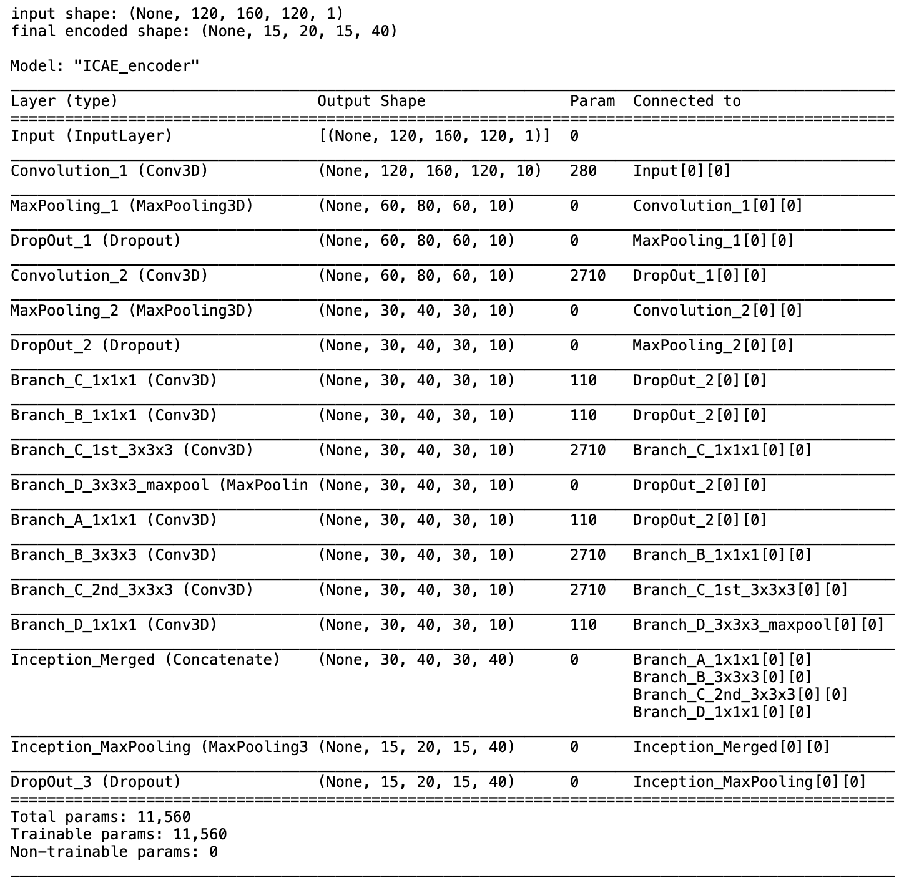
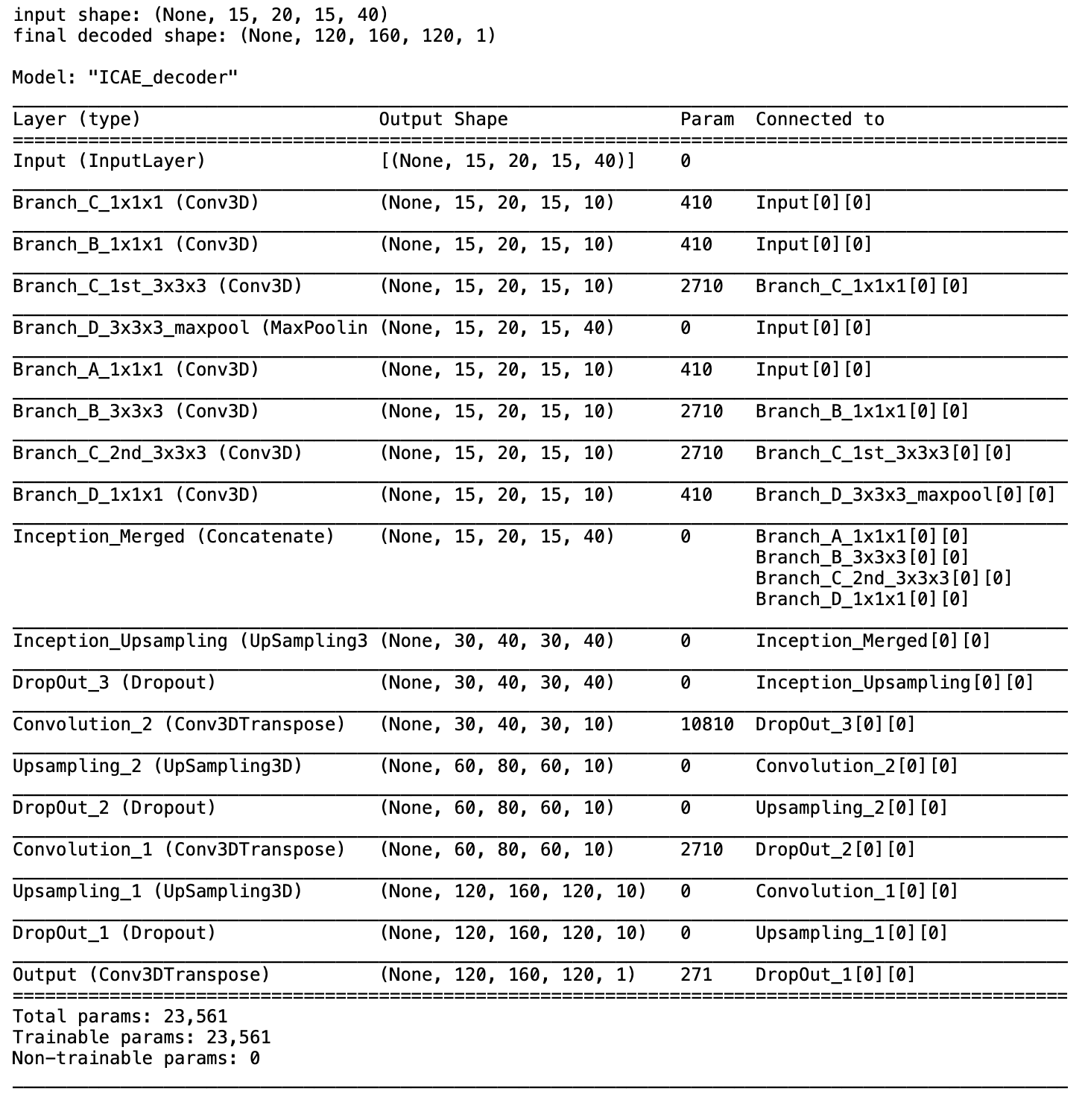
ICAE Autoencoder summary

Slide 11
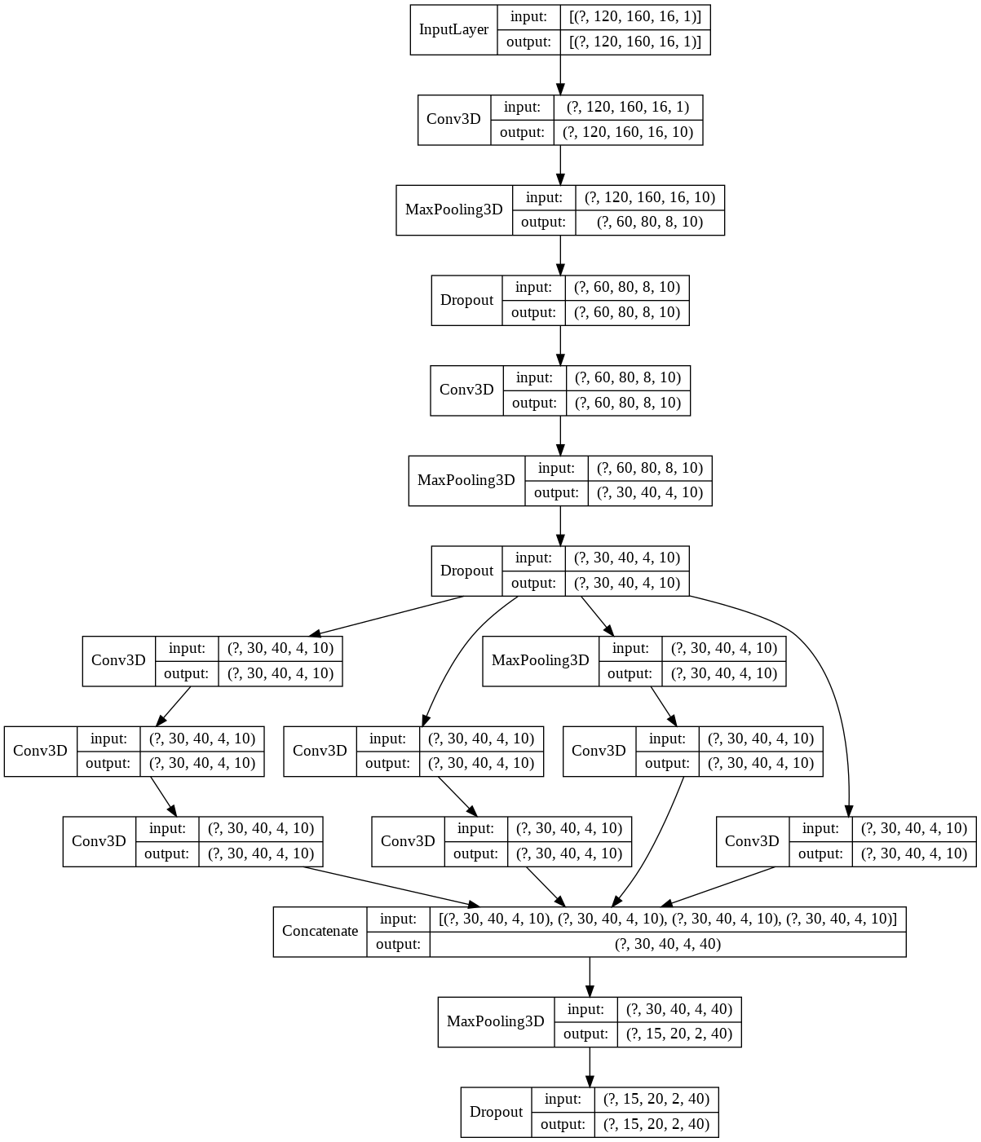
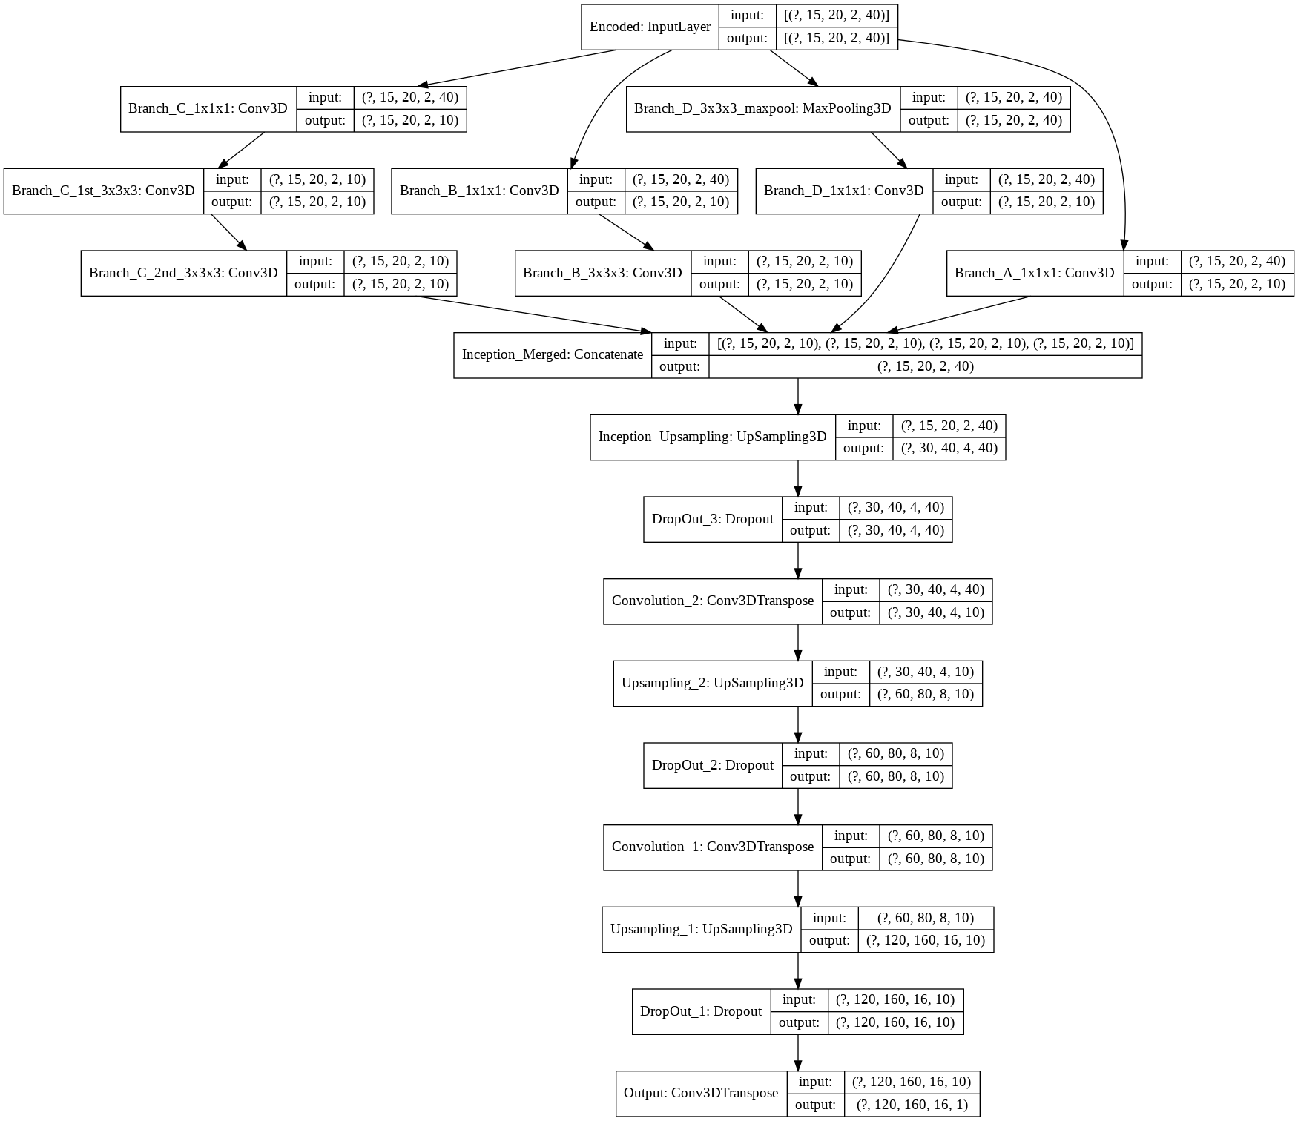
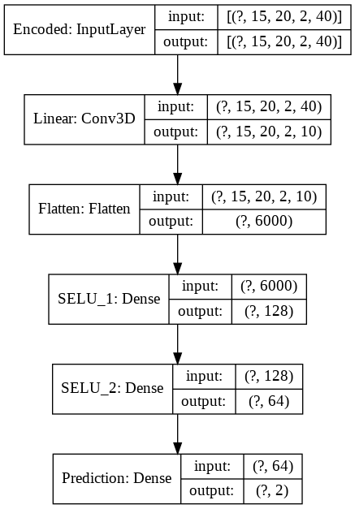
ICAE Model Architecture

Slide 12
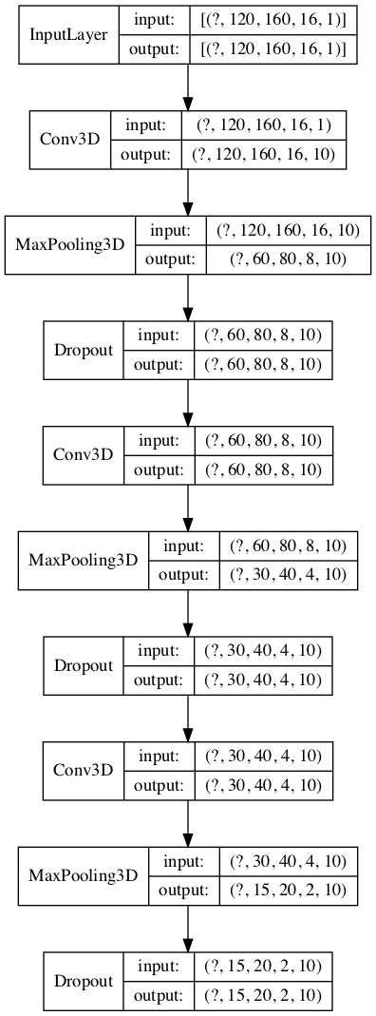
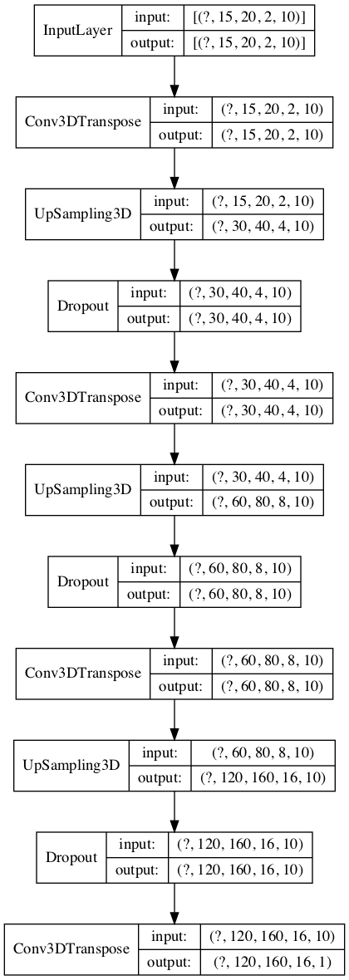
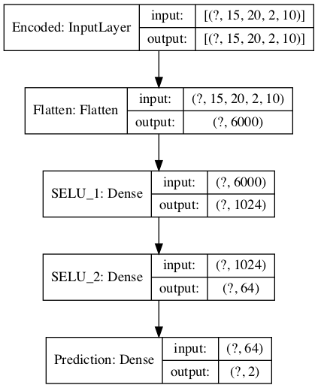
Final Best Model Architecture: CAE with augmentation

Slide 13
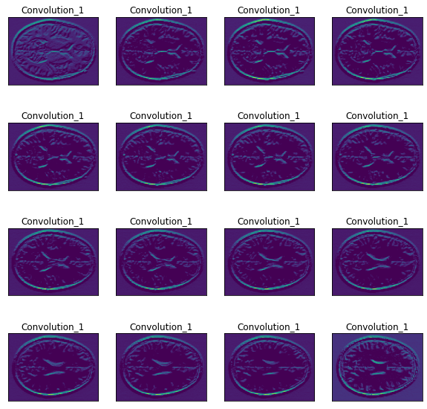
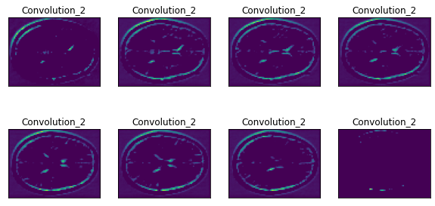
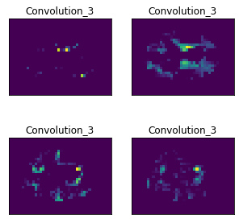
Evolution of Features across Convolutional Layers

Slide 14
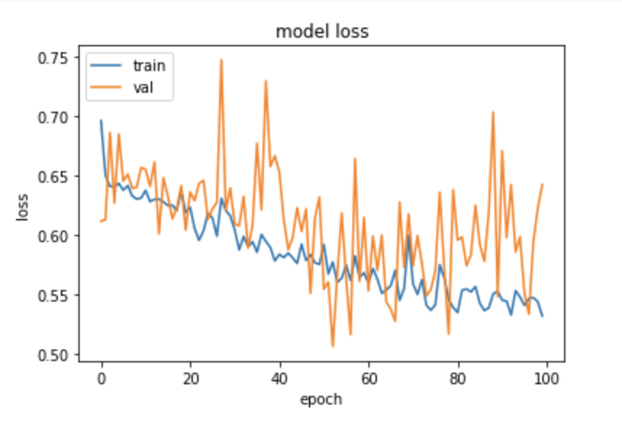
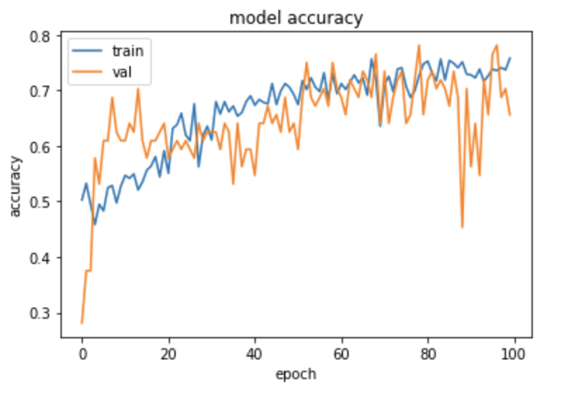
Training process Loss and Accuracy (CAE)

Slide 15
Results and Experiments
Model/ architecture | Epochs | Batch size | Dropout | Train Accuracy | Test Accuracy | Precision | Recall | AUC
CAE (Not stratified, not augmented) | 50 | 2 | 0.8 | 0.63 | 0.37 | 0.60 | 0.60 | 0.66
CAE aug+strat | 100 | 32 | 0.5 | 0.76 | 0.59 | 0.60 | 0.59 | 0.57
ICAE (no aug) | 100 | 32 | 0.2 | 0.76 | 0.56 | 0.52 | 0.56 | 0.55
ICAE (aug) | 25 | 32 | 0.8 | 0.64 | 0.63

Slide 16
Contributions
Data preprocessing (Daniel)
Creating Convolutional Autoencoder (Arezoo)
Creating Convolutional Autoencoder with Inception module (Andrea)
Creating a classifier using CAE (Arezoo)
Creating a generator to solve the big data issues (Batch size 2, non stratified train and test data, non-augmented data) (Arezoo)
New generator with increase in batch size, stratified train and test data and augmented training data by rotation (Daniel)
Creating end-to-end architecture (having the autoencoder and classifier in one architecture) (Daniel)
Dealing with class imbalance with further assigning weights to different classes (Andrea)
Experiments done by changing the input size(16 slices), increasing batch size (Daniel)
Experiments done by changing the architecture (increasing number of neurons in the dense layer), etc. (Daniel)
Experiments done on training model. (Andrea)
Making architecture plots (Andrea)
Visualization of the convolutional layers (Arezoo)
GitHub wiki initialization (Andrea)
Presentation initialization (Arezoo)

Slide 17
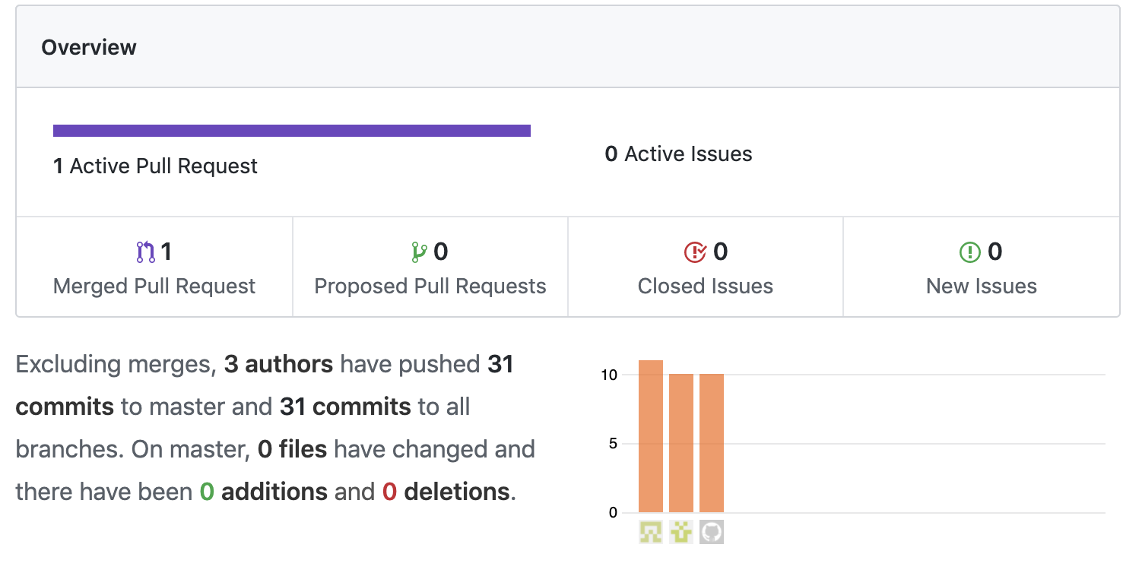
GitHub Commits
Left to right:
Andrea
Arezoo
Daniel

Slide 18
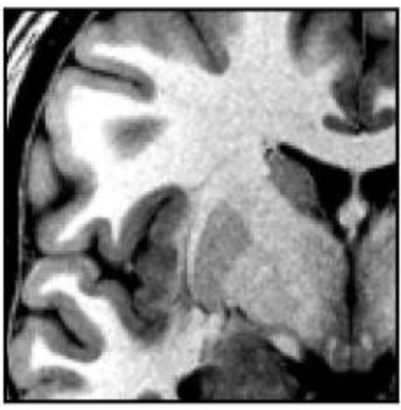
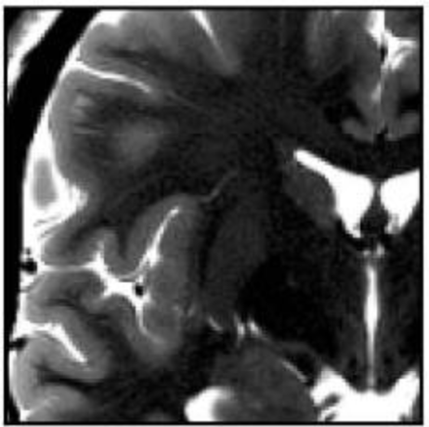
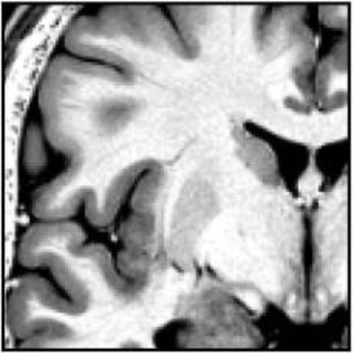
Novel Research
Investigate benefit of T2 contrast enhancement

